Slide 1
Network Cables

Slide 2
Network cables
Network cables are physical media used to connect computers, servers, switches, and other network devices to transfer data between them. They are a fundamental component of wired network infrastructures. There are several types of network cables, each designed for specific purposes and use case. Following are the most common types of Network Cables:
Twisted Pair Cables
Coaxial Cables
Fiber Optic Cables

Slide 3
Twisted Pair Cables
A twisted pair cable is a type of wiring where two conductors are twisted together to cancel out electromagnetic interference (EMI) from external sources, such as electromagnetic radiation from other cables and noise from other electronic devices.
Twisting the wires reduces interference and crosstalk, improving the quality and speed of data transmission over longer distances.
Twisted pair cables are commonly used in telecommunication and networking to transmit data.
There are two main types:
Unshielded Twisted Pair (UTP): The most common form, used in Ethernet cables (like Cat5e, Cat6), telephone lines, and other data transmission applications.
Shielded Twisted Pair (STP): Includes additional shielding to protect against EMI, offering better performance in environments with high interference.

Slide 4
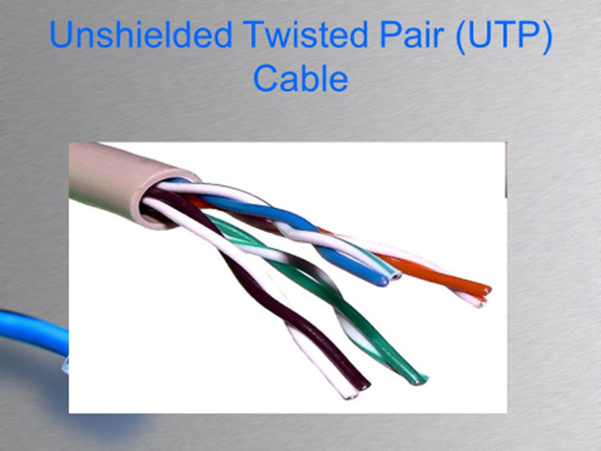
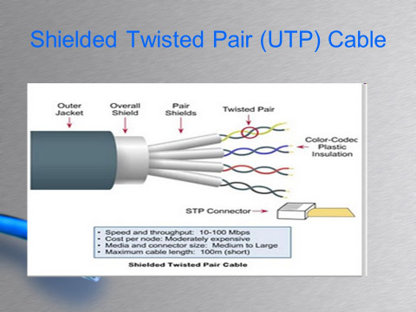

Slide 5
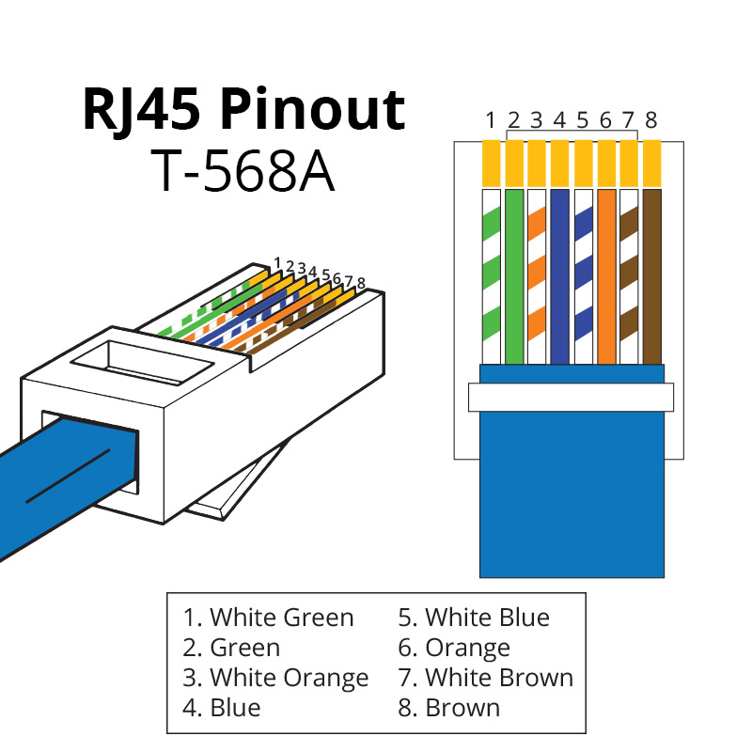

Slide 6
Twisted Pair Ethernet Cable Categories
Category | MAX Speed | Bandwidth | MAX Distance | Cable Types | Use Case
Cat3 | 10 Mbps (Ethernet) | 16 MHz | 100 meters | Unshielded Twisted Pair (UTP) | Early Ethernet, legacy telephone systems
Cat5 | 100 Mbps (Fast Ethernet) | 100 MHZ | 100 meters | Unshielded Twisted Pair (UTP) | Legacy Ethernet networks
Cat5 e | 1 Gbps (Gigabit Ethernet) | 100 MHZ | 100 meters | Unshielded Twisted Pair (UTP) | Common for home and small office networks
Cat6 | 1 Gbps (up to 100 m) | 250 MHz | 100 meters (1 Gbps), 55 meters (10 Gbps) | UTP or STP | Modern networks, small data centers
Cat6a | 10 Gbps (Gigabit Ethernet) | 500 MHz | 100 meters | STP | Data centers, high-speed networks
Cat7 | 10 Gbps | 600 MHZ | 100 meters | Shielded with GG45/TERA connectors | High-performance networking environments

Slide 7
Twisted Pair Ethernet Cable Categories (Cont.)
Category | MAX Speed | Bandwidth | MAX Distance | Cable Types | Use Case
Cat7a | 40 Gbps (short distances) | 1000 MHZ | 100 meters (lower speeds), shorter for higher | Shielded with GG45/TERA connectors | High-end data centers, specialized uses
Cat8 | 25-40 Gbps | 2000 MHZ | 30 meters | Shielded Twisted Pair (STP) | Data centers, short-range high-speed connections

Slide 8
T568A & T568B Standard
T568A and T568B are two standards for wiring Ethernet cables (specifically, twisted-pair copper cables like Cat5e, Cat6, etc.) and define the pinout (wire arrangement) for connecting to RJ45 connectors. These standards are defined by the TIA/EIA (Telecommunications Industry Association/Electronic Industries Alliance) under the TIA/EIA-568 standard. The main difference between them lies in the order of wire pairs in the connector, even though both achieve the same performance for Ethernet.

Slide 9
T568A Standard
The T568A wiring standard was originally intended to be the primary standard for Ethernet wiring, particularly in residential and government installations. It is still widely used in homes and older installations because of its compatibility with both voice (telephone) and data applications.
T568A Pinout (Wire Color Arrangement)Here is the pinout for the T568A standard:
Pin | Color | Wire Pair
Pin 1 | White/Green | Pair 3 (TX+)
Pin 2 | Green | Pair 3 (TX-)
Pin 3 | White/Orange | Pair 2 (RX+)
Pin 4 | Blue | Pair 1 (Unused, PoE)
Pin 5 | White/Blue | Pair 1 (Unused, PoE)
Pin 6 | Orange | Pair 2 (RX-)
Pin 7 | White/Brown | Unused
Pin 8 | Brown | Unused

Slide 10
T568B Standard
The T568B standard is more widely used in commercial and modern Ethernet installations due to its historical adoption in business and IT infrastructure. While it offers the same performance as T568A, many businesses prefer it due to familiarity and widespread usage.
T568B Pinout (Wire Color Arrangement)
Here is the pinout for the T568B standard:
Pin | Color | Wire Pair
Pin 1 | White/Orange | Pair 2 (TX+)
Pin 2 | Orange | Pair 2 (TX-)
Pin 3 | White/Green | Pair 3 (RX+)
Pin 4 | Blue | Pair 1 (Unused, PoE)
Pin 5 | White/Blue | Pair 1 (Unused, PoE)
Pin 6 | Green | Pair 3 (RX-)
Pin 7 | White/Brown | Pair 4 Unused
Pin 8 | Brown | Pair 4 Unused

Slide 11
Straight-Through Cable
A straight-through cable is the most commonly used Ethernet cable for connecting different types of devices.
Purpose: Used to connect different types of devices, such as a computer to a switch or router, or a router to a modem.
Wiring Standard: Both ends use the same wiring standard, either T568A or T568B.
T568A: Pin configuration at both ends follows the T568A standard.
T568B: Pin configuration at both ends follows the T568B standard.
Pin Configuration: For both ends (same for T568A or T568B):
Pin 1 (Transmit) connects to Pin 1 (Receive)
Pin 2 (Transmit) connects to Pin 2 (Receive)
Pin 3 (Receive) connects to Pin 3 (Transmit)
Pin 6 (Receive) connects to Pin 6 (Transmit)
Use Cases: PC to Switch/Hub/Router
Router to Modem

Slide 12
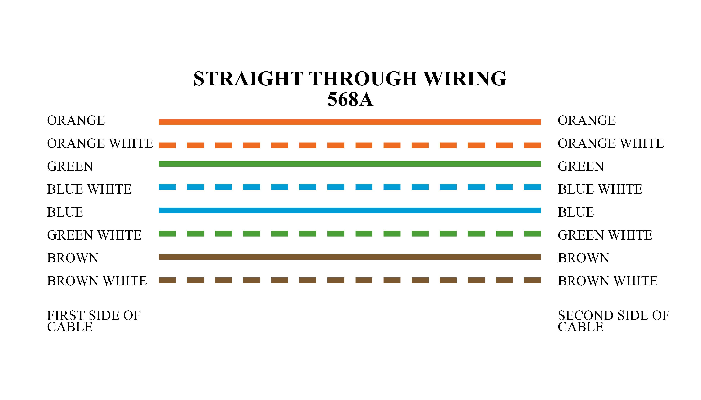
Straight Through Cable

Slide 13
Crossover Cable
A crossover cable is used to connect two similar devices directly without the need for a switch or hub.
Purpose: Used to connect similar devices, such as computer-to-computer, switch-to-switch, or router-to-router without an intermediary device.
Wiring Standard: One end follows the T568A standard, and the other end follows the T568B standard.
Pin Configuration:
T568A end:
Pin 1 (Transmit) connects to Pin 3 (Receive)
Pin 2 (Transmit) connects to Pin 6 (Receive)
Pin 3 (Receive) connects to Pin 1 (Transmit)
Pin 6 (Receive) connects to Pin 2 (Transmit)
Use Cases:
PC to PC
Switch to Switch
Router to Router

Slide 14
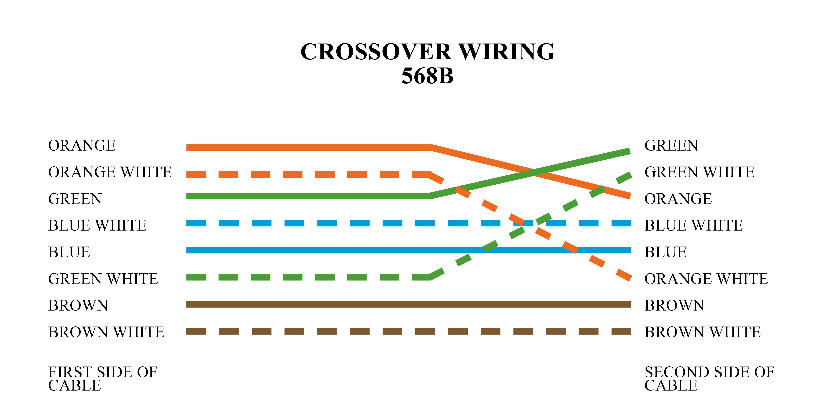
Crossover Cable

Slide 15
Rollover Cable (Console cable)
A rollover cable is used to connect a computer to a router or switch's console port, typically for administrative purposes.
Purpose: Used for connecting a computer to the console port of networking devices, such as Cisco routers or switches for configuration purposes.
Wiring Standard: The pins on one end are completely reversed from the other end.
Pin Configuration:
T568A end:
Pin 1 connects to Pin 8
Pin 2 connects to Pin 7
Pin 3 connects to Pin 6
Pin 4 connects to Pin 5
Pin 5 connects to Pin 4
Pin 6 connects to Pin 3
Pin 7 connects to Pin 2
Pin 8 connects to Pin 1
Use Cases:
Computer to Router/Switch Console Port

Slide 16
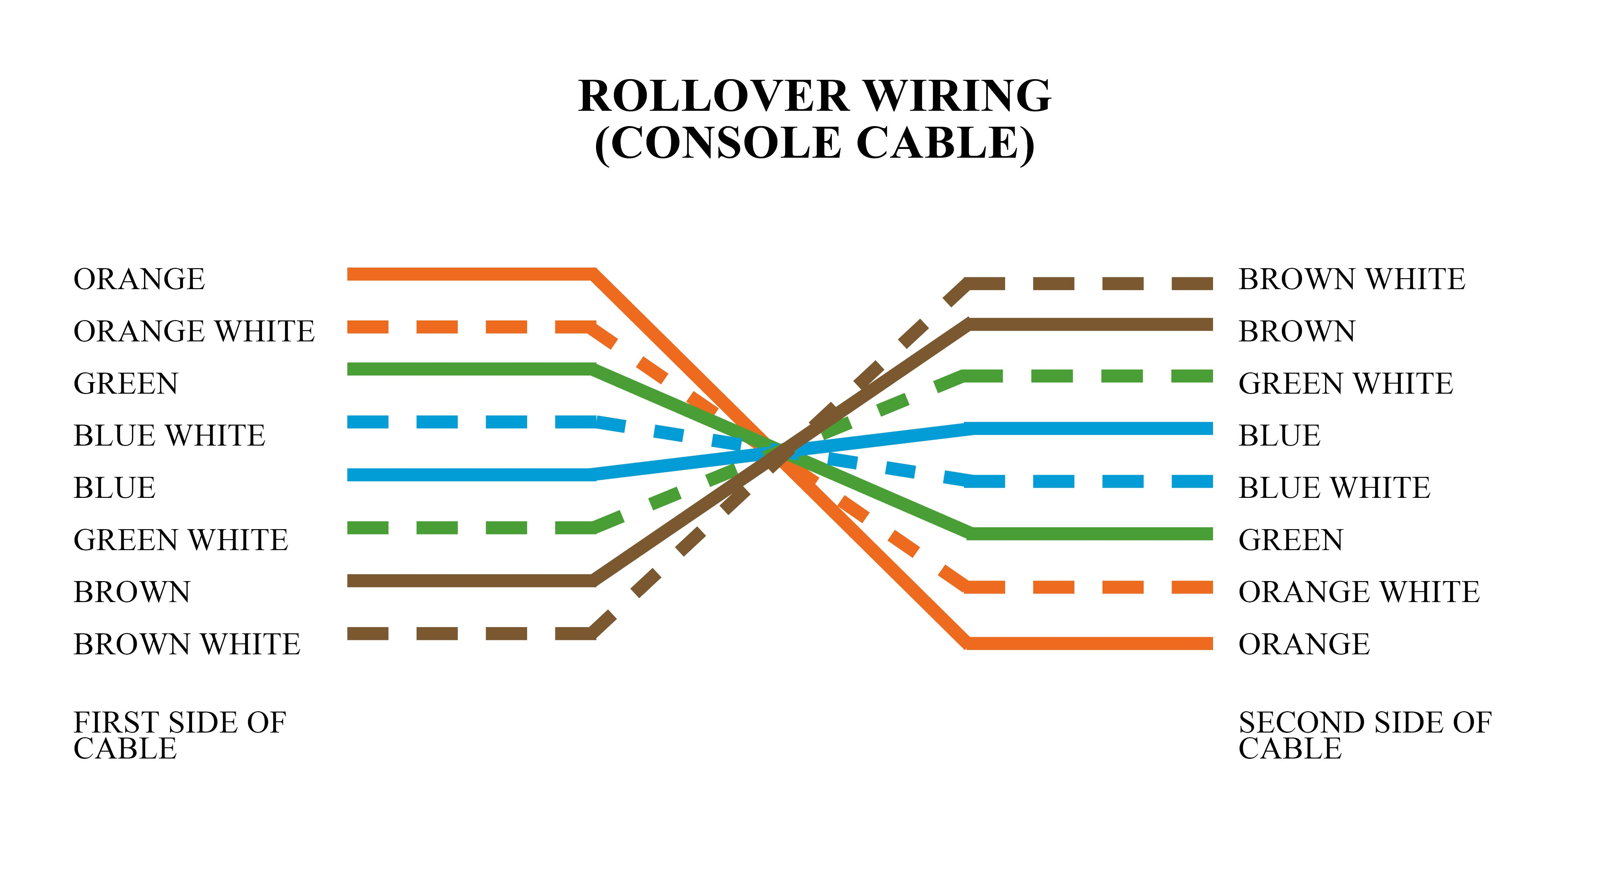
Rollover Cable

Slide 17
Fiber Optic Cable
Fiber optic cables use light to transmit data and offer higher speeds and longer distances compared to copper cables.
Single-mode Fiber (SMF): Description: Single-mode fiber has a smaller core (about 9 microns in diameter) and is used for long-distance transmission, such as in WANs (Wide Area Networks) or undersea cables. It typically supports distances up to 40 kilometers or more.
Use Cases: Long-distance communication, telecommunications, and backbone networks.
Multi-mode Fiber (MMF)Description: Multi-mode fiber has a larger core (50–62.5 microns) and is used for shorter distances, typically up to 500 meters. It is more affordable than single-mode fiber and is commonly used in LANs and data centers.
Use Cases: Short-distance communication, high-speed data transmission in LAN environments.

Slide 18
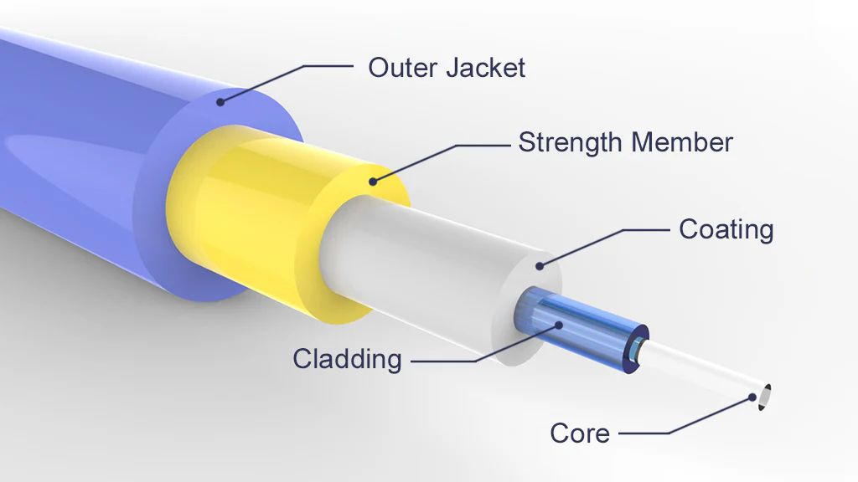
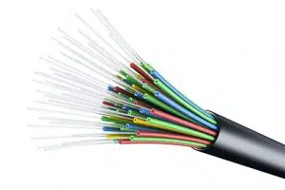
Fiber optic Cable

Slide 19
Coaxial Cables
Description: Coax, short for coaxial, is a type of cable used to transmit data, the internet, video and voice communications. A coax cable is made up of an aluminum and copper shield with an outer plastic jacket (see below) with the dielectric insulator helping to minimize signal loss.
Coaxial cables have a central conductor made of copper, surrounded by an insulating layer, a metallic shield, and an outer insulating layer. These cables are used for high-frequency signal transmission.
Use Cases: Cable TV, internet connections (e.g., DOCSIS standards), and older networking protocols (e.g., Ethernet over coax).
Types:RG-6: Common for cable TV and internet connections.RG-59: Used in older analog video and CCTV systems.

Slide 20
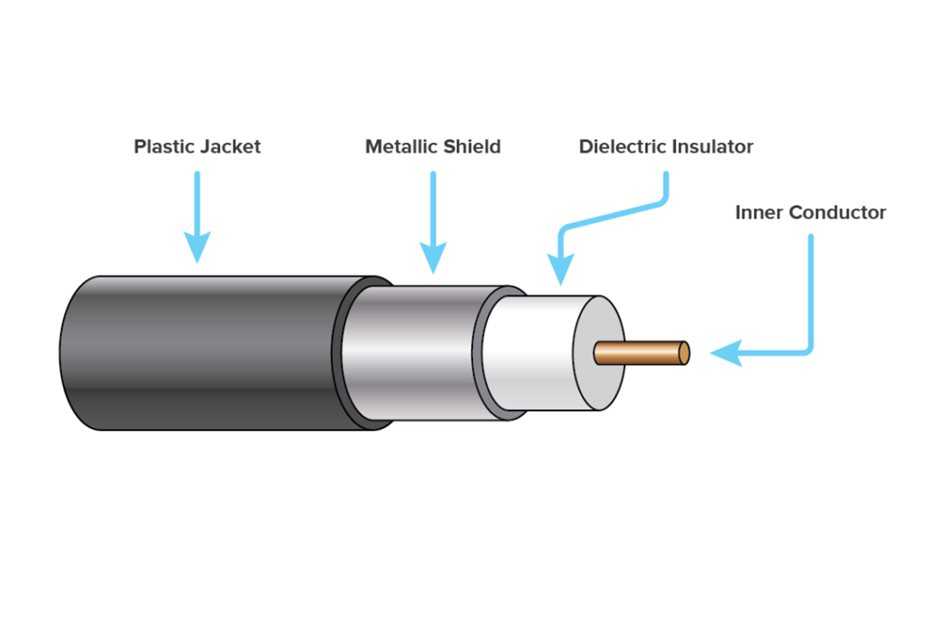
Coaxial Cable

Slide 21
Ethernet Standards
Description: Fast Ethernet and Gigabit Ethernet are two different Ethernet standards that define the speed of data transmission in a network. Each standard has its own specifications for speed, cabling, and use cases.
Fast Ethernet
Fast Ethernet is an Ethernet standard that supports data transfer rates of up to 100 Mbps. It is a step up from the original Ethernet standard, which supported only 10 Mbps.
Key Features of Fast Ethernet:
Speed: Up to 100 Mbps.
IEEE Standard: Defined under IEEE 802.3u.
Cable Types: Typically uses Cat5 or Cat5e twisted-pair Ethernet cables with RJ45 connectors, but can also work over fiber optic cables.
Duplex Modes: Supports both half-duplex (shared bandwidth) and full-duplex (dedicated bandwidth) modes.

Slide 22
Gigabit Ethernet Standards
Description: Gigabit Ethernet is a faster Ethernet standard that supports data transfer rates of 1 Gbps (1000 Mbps), which is 10 times faster than Fast Ethernet. It is now the most widely used standard for home networks, business LANs, and data centers..
Key Features of Fast Ethernet:
Speed: Up to 1 Gbps (1000 Mbps).
IEEE Standard: Defined under IEEE 802.3ab (for copper) and IEEE 802.3z (for fiber).
Cable Types:
For copper wiring, typically uses Cat5e, Cat6, or higher cables.
For fiber optic wiring, it uses 1000BASE-LX (single-mode fiber) or 1000BASE-SX (multi-mode fiber)..
Duplex Modes: Operates in full-duplex mode, meaning it can send and receive data simultaneously, effectively achieving 2 Gbps throughput (1 Gbps in each direction).

